Slide 1
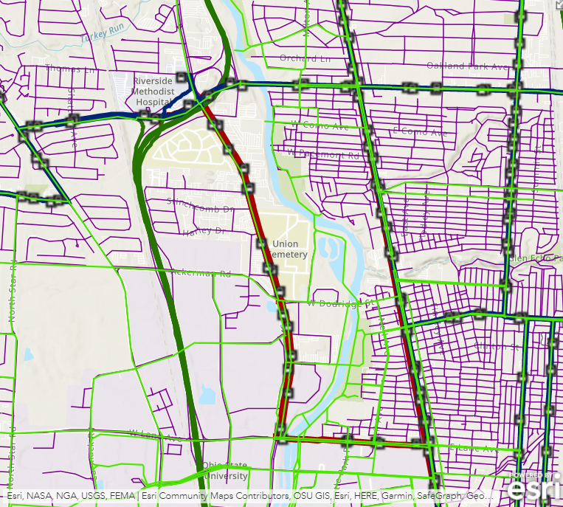
Networks are hard. Multimodal networks are much harder!
Connectivity
Costs
Restrictions
Data availability, attributes, and integration
Also, data and tools can be expensive!
Notes:
Poll: How many have built a car-only street network? How about a multimodal network involving transit?
Was it easy?
In Central Ohio, we are fortunate to have high-quality regional centerline data for the entire region thanks to my colleagues at MORPC and the those of you who maintain the data for your jurisdictions. Statewide, we have centerlines for each county thanks to OGRIP, and statewide centerlines for major roads thanks to ODOT. But what if your study area extends beyond the region or the state? Nationwide datasets are available, but proprietary datasets may be expensive.
Tools can also be expensive. Depending on the application combined license costs for tools and data could easily reach several thousand dollars.

Slide 2

Sometimes you need foolproof routing or research-grade analysis.
Source: NBC
Notes:
Sometimes the high cost is justified. If you need the highest accuracy data and full control over network behavior to ensure safe routing guidance or to produce an academically-defensible analysis, then perhaps it makes sense to expend the effort and cost associated with building a network from scratch using local data.

Slide 3
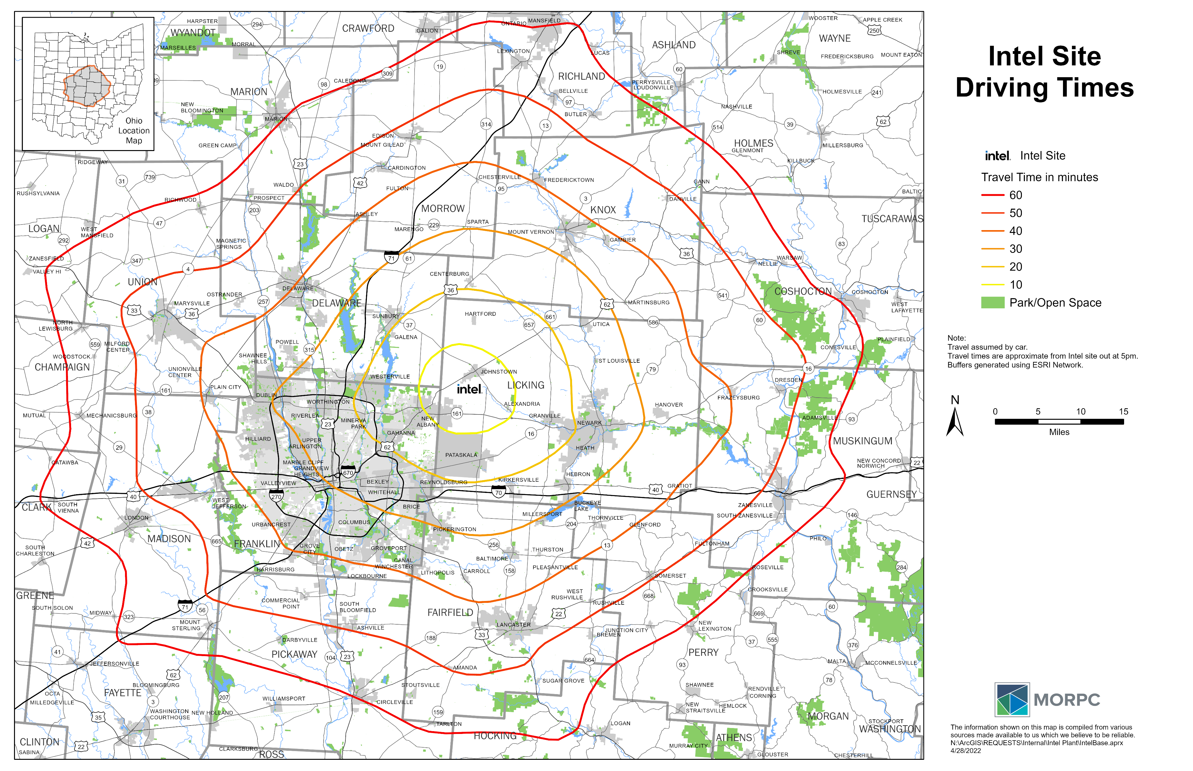
But sometimes you just need a general sense of a place… and the people and things that are nearby.
Source: City of New Albany
Notes:
But, as my colleague Cheri likes to put it, sometimes the juice ain’t worth the squeeze. I think that applies in the context of performing accessibility analyses on a regional scale.
In these cases, we are trying to gain a broad understanding the regional situation, and possibly how it will change many years into the future.
Thinking a lot about Intel lately. Everyone wants to know what this is going to mean and how it will effect the region. At such a large scale and with so much uncertainty, does it really matter if a speed limit or U-turn constraint is wrong?

Slide 4




Luckily, there are (open source) apps for that!
Network of roads, trails, sidewalks, etc.
Network of transit routes (“GTFS”)
“R5” routing engine
(Rapid Realistic Routing on Real-world and Reimagined networks)
One R package to rule them all and on the PC bind them!

Slide 5
You sound like a pirate. What aarrrr you talking about?
Accessibility: The number of opportunities reachable on the network given a set of conditions.
History
Publications
2009: OpenTripPlanner brings multi-modal point-to-point routing, but limited accessibility tools.
2016: R5 brings accessibility tools, but intended for OTP2 and Conveyal Analysis platform. Not well documented or easy to use.
2020: R5R brings the power of R5 to mere mortals through bundling of the engine and a simple interface.
Stewart and Byrd (2021): Interactive Access for Integrated Planning. Chapter 17 in Applications of Access
Conway and Stewart (2019): Getting Charlie off the MTA: a multiobjective optimization method to account for cost constraints in public transit accessibility metrics
Conway, Byrd, and van Eggermond (2018): Accounting for uncertainty and variation in accessibility metrics for public transport sketch planning
Conway, Byrd, and van der Linden (2017): Evidence-Based Transit and Land Use Sketch Planning Using Interactive Accessibility Methods on Combined Schedule and Headway-Based Networks
Notes:
2016: OpenTripPlanner provides multi-modal
Example: COTA Trip Planner
Good at point-to-point routing
Limited accessibility tools (“Analyst” mode)
2. RRRR aka “R4” (pre-2014)
“RRRR Rapid Realtime Routing”
Still just for routing, but faster
Uses RAPTOR transit routing algorithm
R5 (circa 2020)
“Rapid Realistic Routing on Real-world and Reimagined networks”
Built for accessibility, but still good at routing
Engine for Conveyal Analysis platform,
Open source, but not well documented
R5R brings the power of R5 to mere mortals

Slide 6
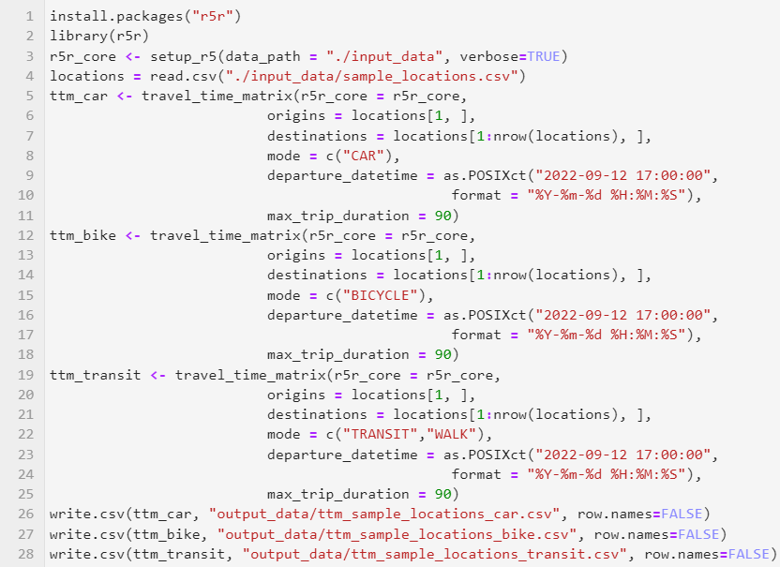
That’s great, but how does it work?
Install and load r5r
Build network from OSM and GTFS
Load origin and destination coordinates
Compute travel time matrices for several modes (car, bike, transit)
Total runtime:
2.02 minutes
(4 cores @ 3GHz, 16GB RAM)
Write the matrices to CSV

Slide 7
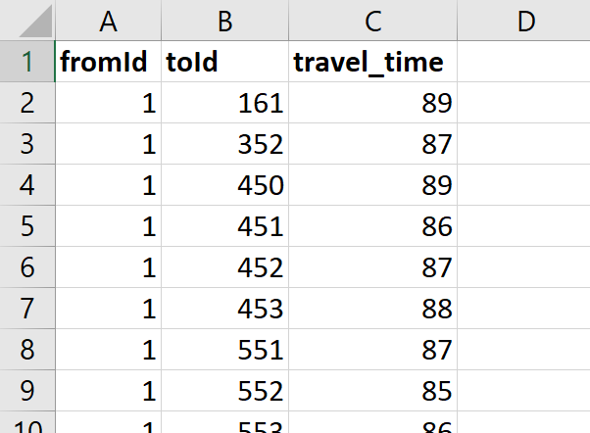
The result doesn’t look very impressive at first…

Slide 8
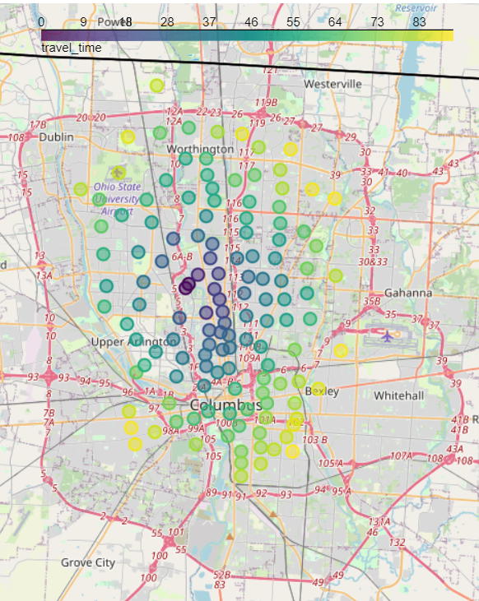
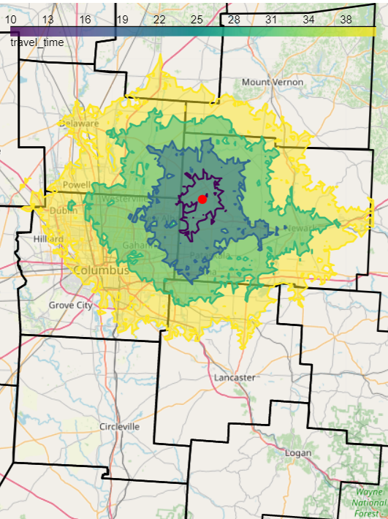
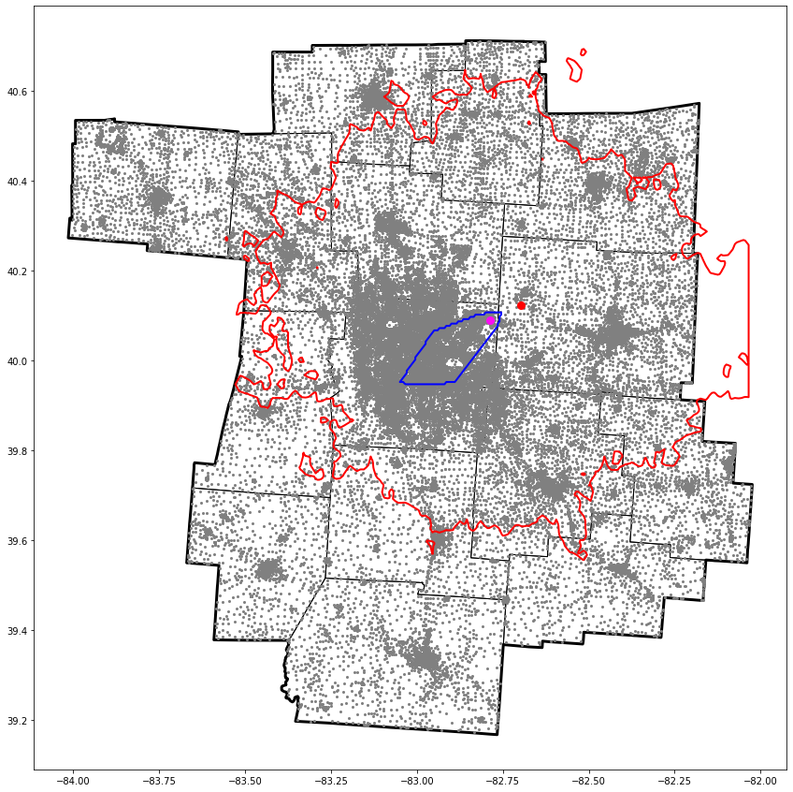
… but with a little GIS work, cool things are possible!
Travel times point-to-point
Travel time rings
Accessibility analysis
Notes:
That’s all the coding required. The rest is just regular old GIS work.

Slide 9
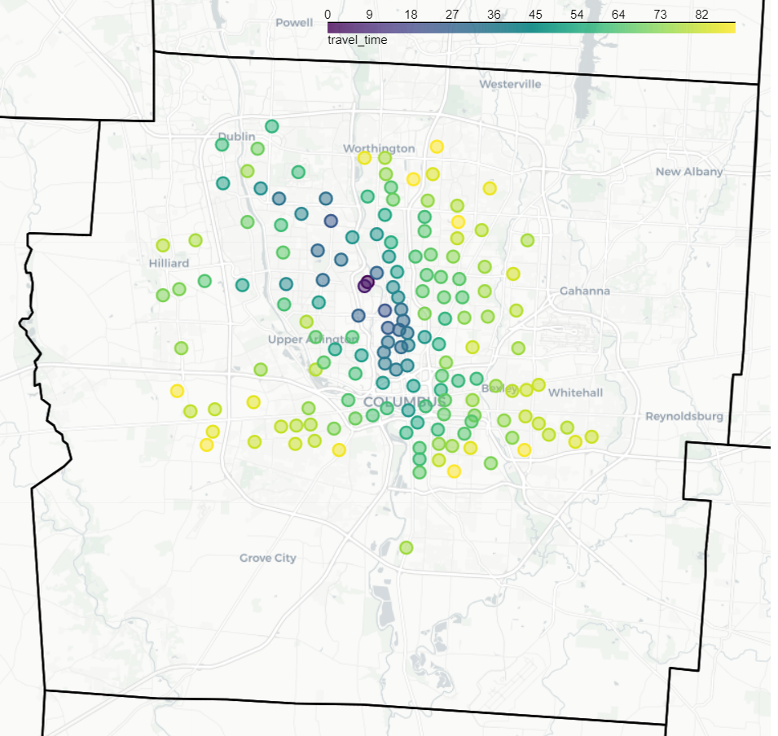
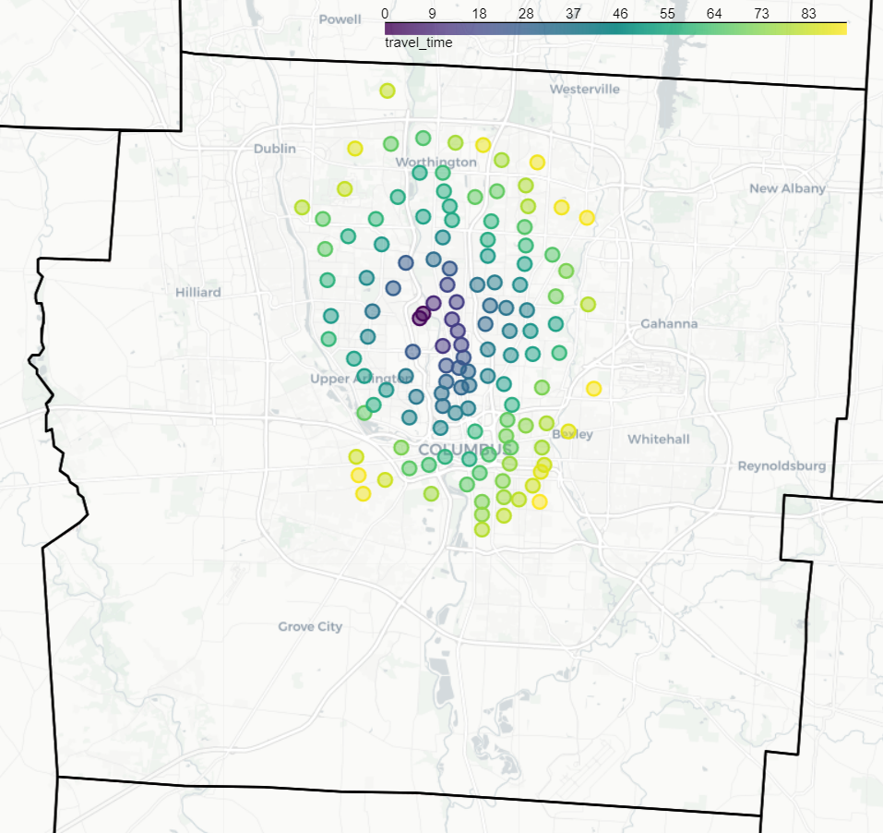
Example - Travel time comparison by mode
Transit
Bike
Notes:
That’s all the coding required. The rest is just regular old GIS work.

Slide 10
Example - Travel time rings

Slide 11
Example – Accessibility analysis

Slide 12
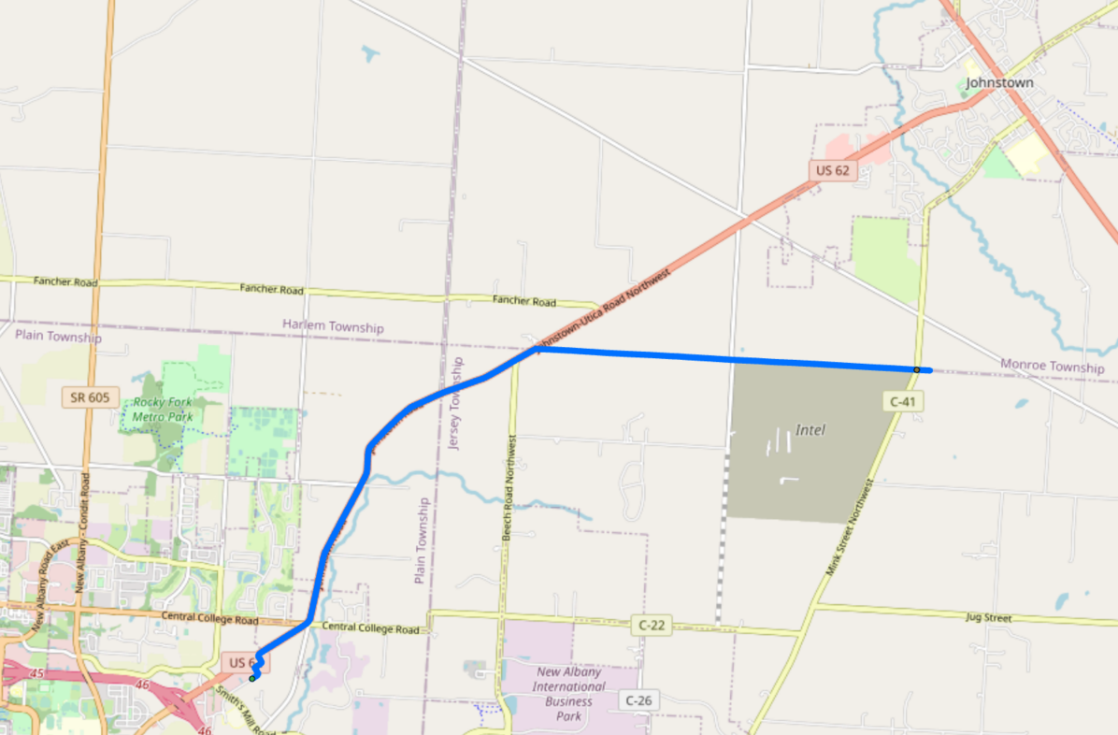
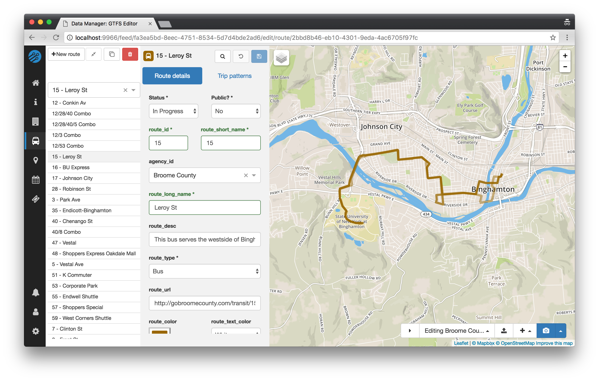
What if we were to…
…model a new COTA stop at the Intel site?
…model a new fixed-route service to serve Licking County?
…model a new bike path between the site and the New Albany park and ride and/or Johnstown?
…improve the OSM data?
Feature completeness (esp. bike/ped)
Attribute completeness (Level of Traffic Stress)

Slide 13
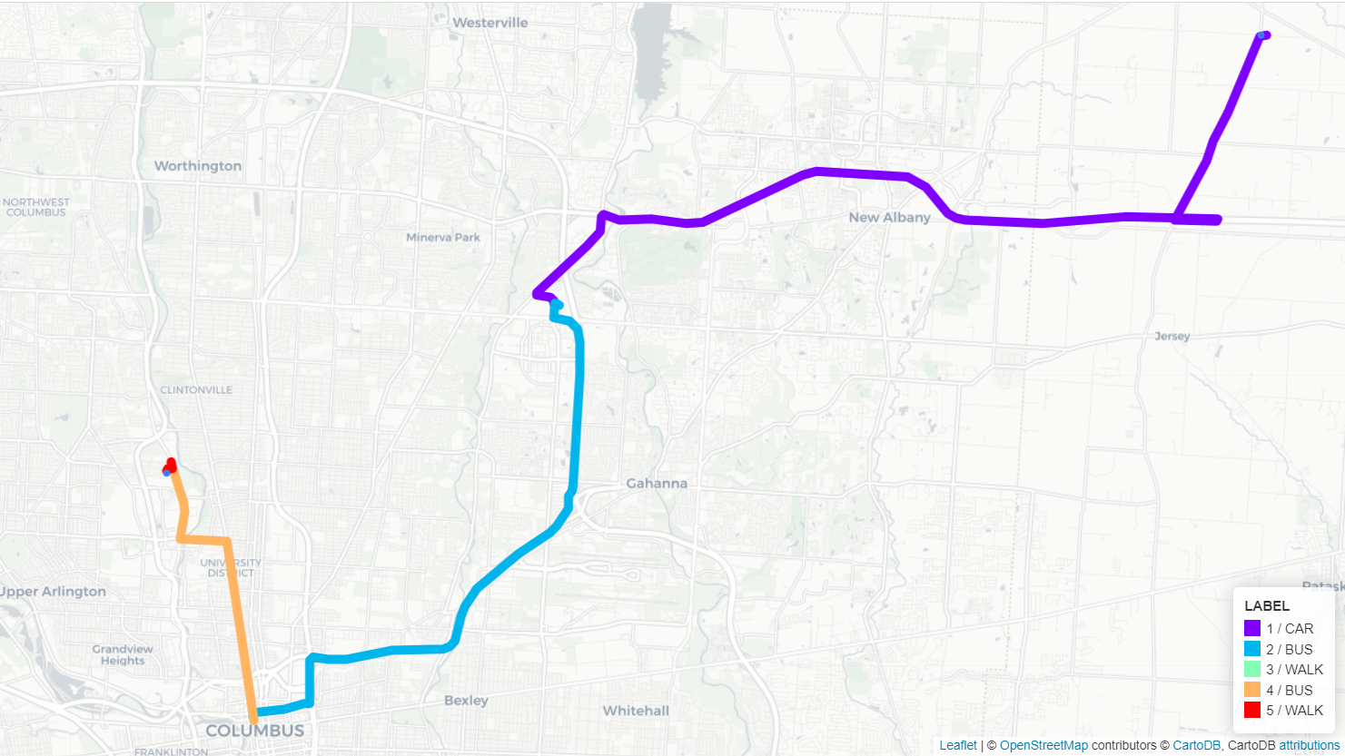
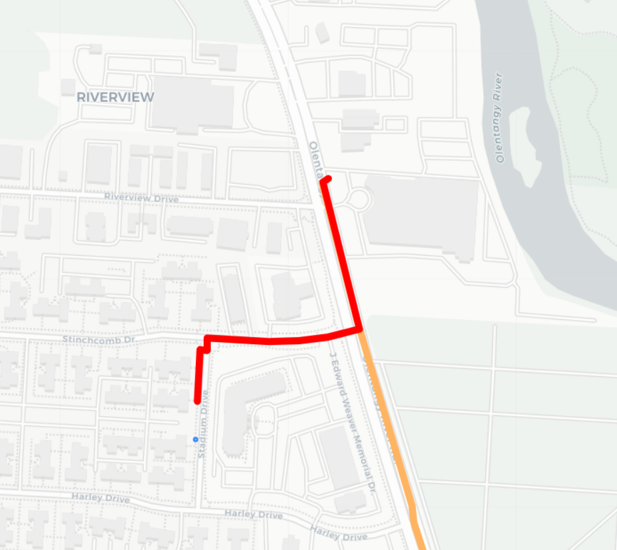
Naturally, it can generate itineraries too.
Notes:
That’s all the coding required. The rest is just regular old GIS work.

Slide 14
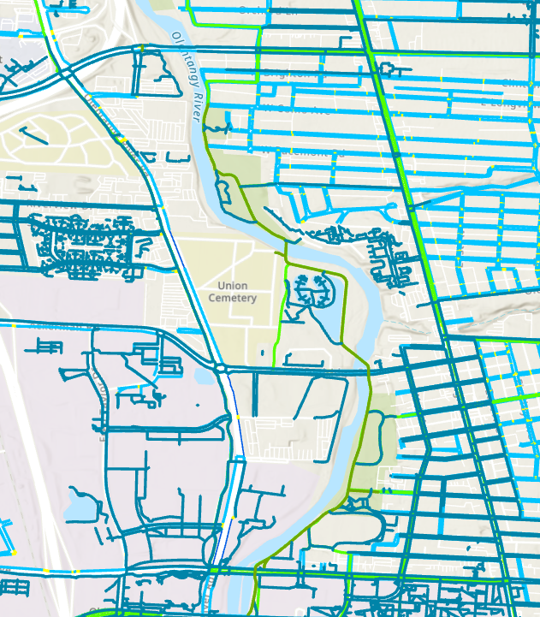
Lessons learned and caveats
R5R doesn’t (yet) provide access to all features of R5 (e.g. custom ingress modes)
Computation of inbound routes is much slower than outbound routes?
Router does not allow boarding at New Albany Park and Ride?
OpenStreetMap network isn’t perfect in Central Ohio…
No sidewalks
Incomplete greenways
No Level of Traffic Stress
… and yet, many companies are selling or relying on OSM-based products.
Need to fully understand or fine tune network behavior? Stick with ArcGIS.
There is a Python equivalent (r5py), but it doesn’t seem as mature or functional as r5r (yet).

Slide 15
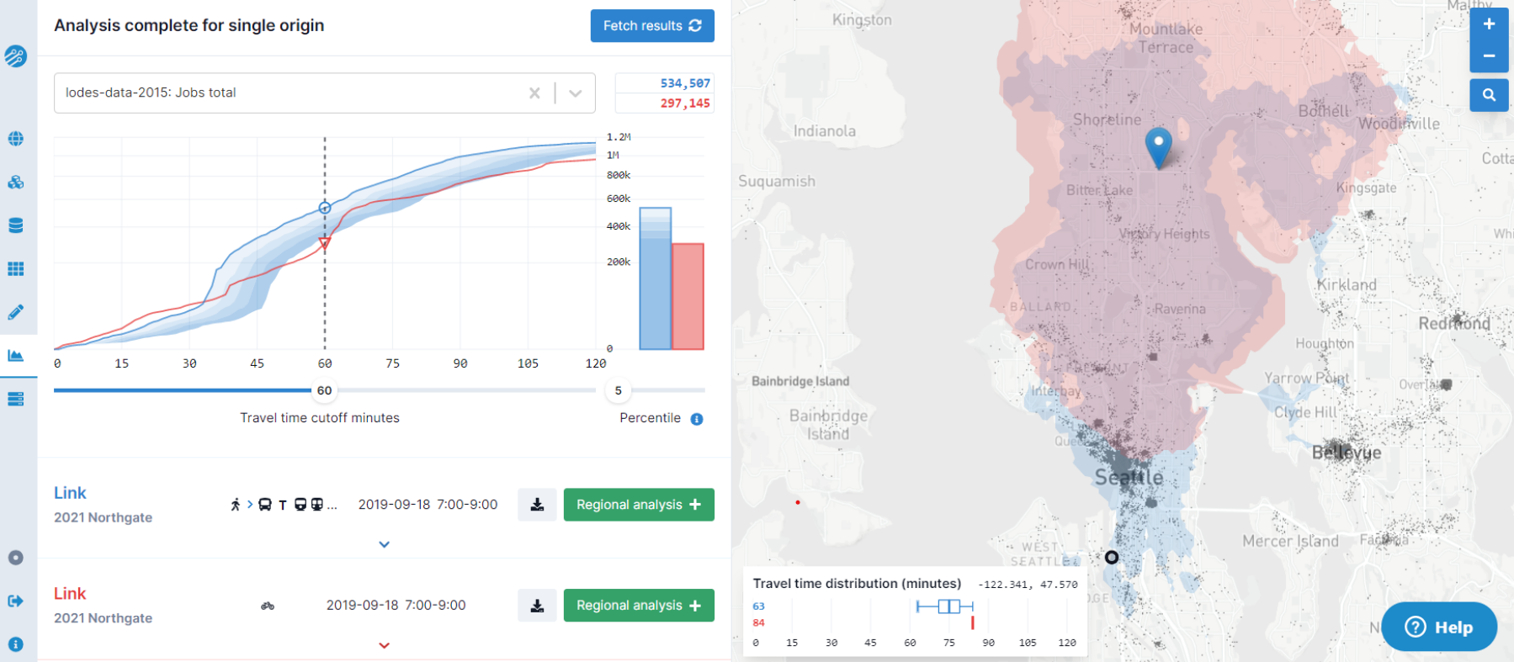
Sounds like too much work? Try Conveyal!
https://conveyal.com/

Slide 16
Thank you! Questions?

Slide 17
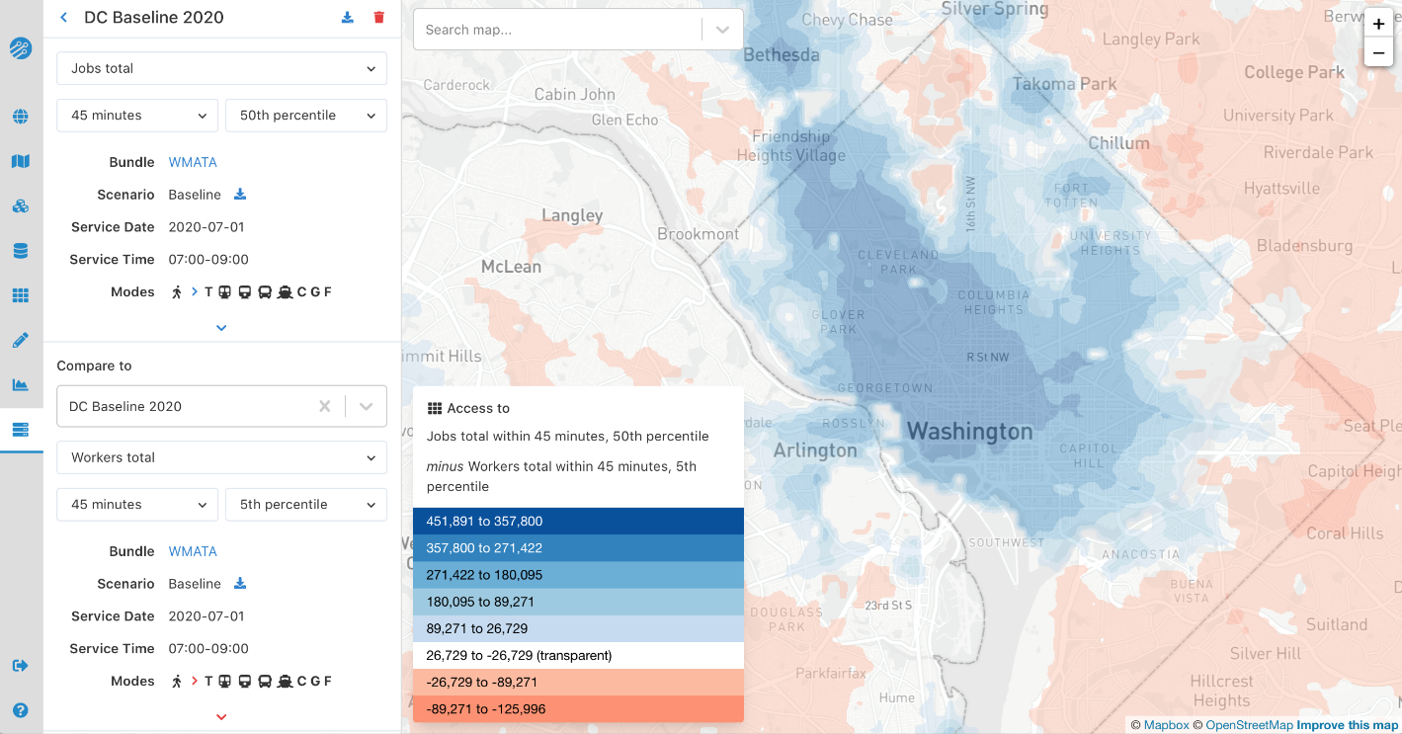
More Conveyal
https://conveyal.com/

Slide 18
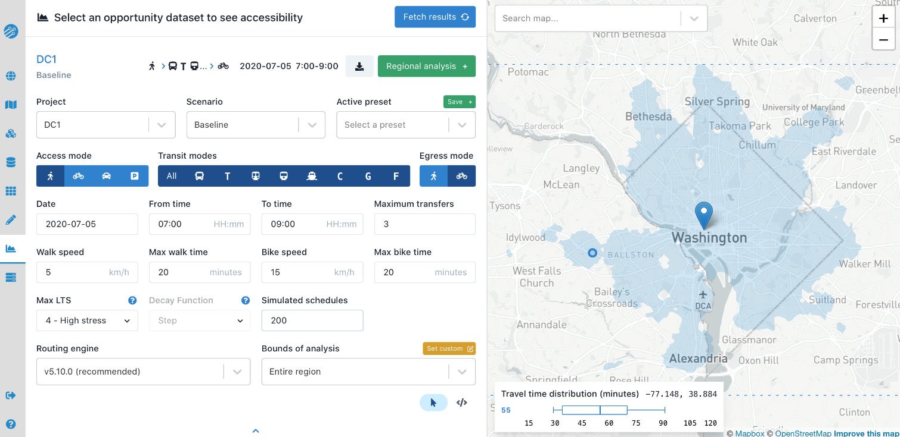
More Conveyal
https://conveyal.com/

